Slide 1
COMP 301 Analysis of Algorithms
Heap Sort

Slide 2

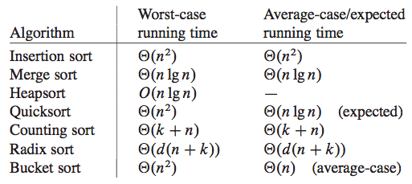
Sorting Problem

Slide 3
Order Statistics
The ith order statistic of a set of n numbers is the ith smallest number in the set.
Approach 1: Sort the numbers and then select the ith smallest
Approach 2: Randomized algorithm in chapter 9
Expected running time
Worst-case running time

Slide 4
Heap Sort
Running time is O(n logn)
Uses heap data structure
Not the heap in Java’s garbage-collected storage

Slide 5
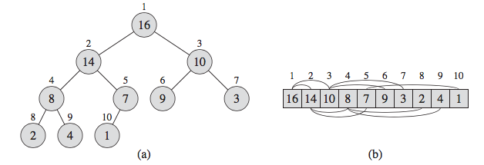
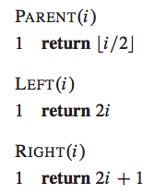
Binary Heap Data Structure

Slide 6
Heap Properties
Max-heap property
For every node i other than root
Min-heap property
For every node i other than root

Slide 7
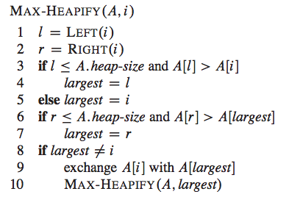
Maintaining the Heap Property

Slide 8
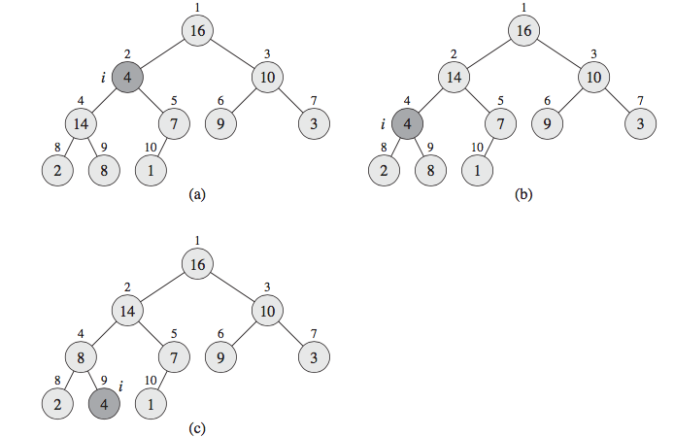
Max Heapify Example

Slide 9
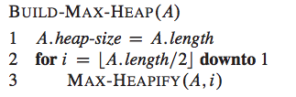
Building a Heap

Slide 10
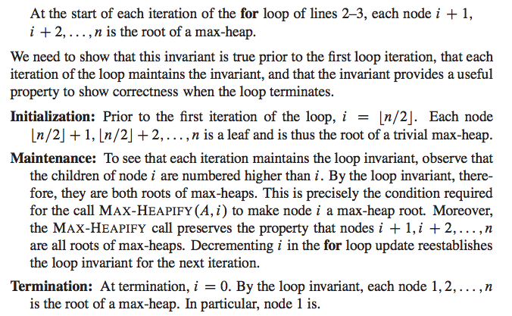
Loop Invariant for Build Heap

Slide 11
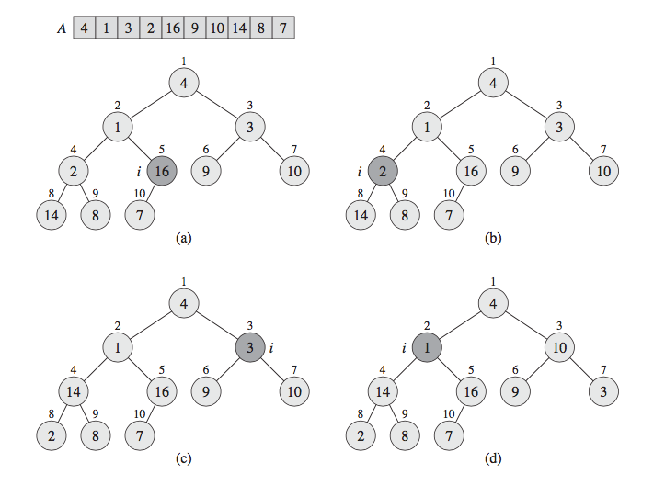
Build Max Heap Example

Slide 12
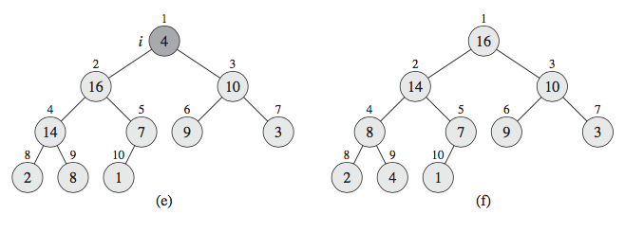
Build Max Heap Example

Slide 13
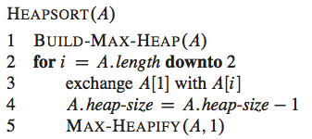
Heap Sort

Slide 14
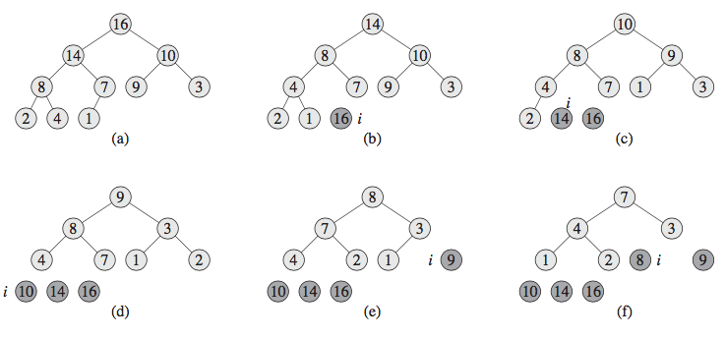
Heap Sort Example

Slide 15
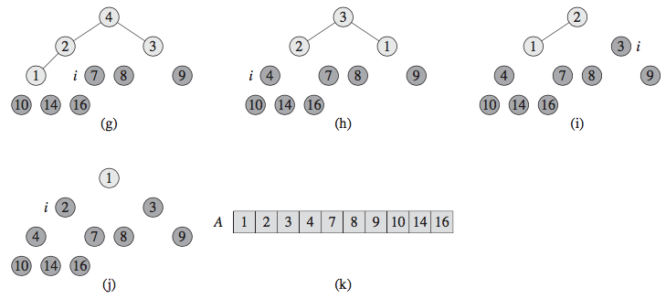
Heap Sort Example

Slide 16
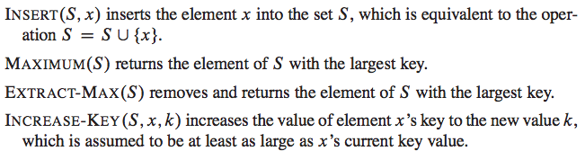
Priority Queues
A data structure for maintaining a set S of elements, each with an associated value called a key.
A max-priority queue supports the following operations:

Slide 17
Priority Queues
We can use max-priority queues to schedule jobs on a shared computer
The max-priority queue keeps track of the jobs to be performed and their relative priorities
When a job is finished or interrupted, the scheduler selects the highest-priority job from among those pending by calling EXTRACT-MAX
The scheduler can add a new job to the queue at any time by calling INSERT.

Slide 18
Priority Queues
A min-priority queue supports the operations INSERT, MINIMUM, EXTRACT-MIN, and DECREASE-KEY
A min-priority queue can be used in an event-driven simulator
The items in the queue are events to be simulated, each with an associated time of occurrence that serves as its key
The events must be simulated in order of their time of occurrence, because the simulation of an event can cause other events to be simulated in the future

Slide 19
Priority Queues
The simulation program calls EXTRACT-MIN at each step to choose the next event to simulate
As new events are produced, the simulator inserts them into the min-priority queue by calling INSERT.

Slide 20
Implementing Priority Queues
We can use a heap to implement a priority queue
Elements of a priority queue correspond to objects in the application
We often need to store a handle (pointer or integer) to the corresponding application object in each heap element
We need to store a handle to the corresponding heap element in each application object (typically array index)
Handles might need to be updated during heap operations

Slide 21

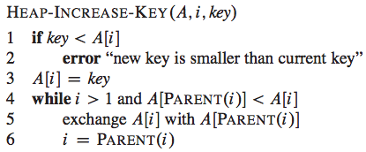
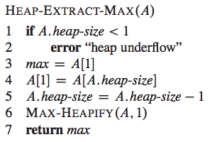
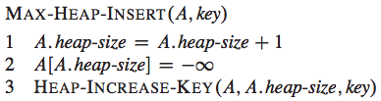
Heap Operations of Max Priority Queue

Slide 22
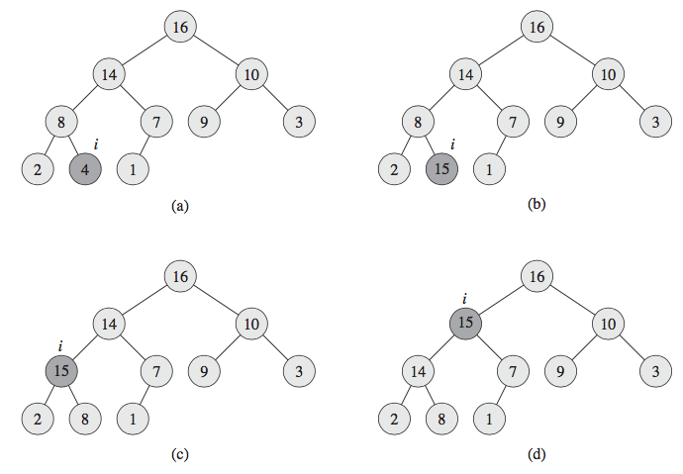
Example: Heap Increase Key

